Slide 1
Informatica MDM - Multidomain
Colm Moynihan – Technical Director
13rd Feb 2012

Slide 2
Agenda
Introduction
MDM Partner Offering
MDM Features
Reference Data Management Accelerator
Competitive Intelligence
Enablement
Summary

Slide 3
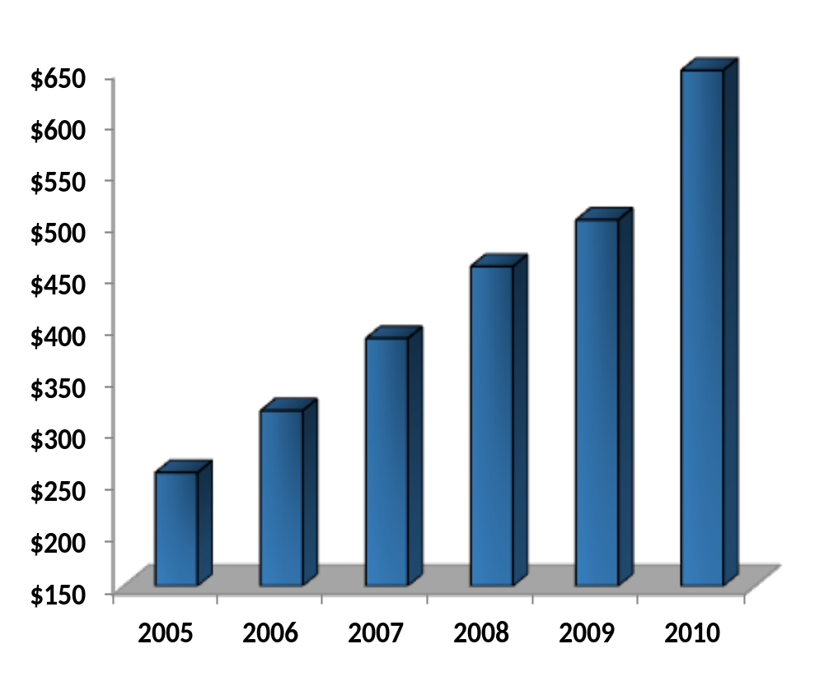
Informatica
The #1 Independent Leader in Data Integration
Founded: 1993
2010 Revenue: $650 million
5-year Average Growth Rate:
20% per year
Employees: 2,478
Partners: 400+
  Major SI, ISV, OEM and On-Demand Leaders
Customers: 4,500
  > 70% of the Global 500
  Customers in 82 Countries
  Direct Presence in 26 Countries
  # 1 in Customer Loyalty Rankings (6 Years in a Row)
Notes:
3

Slide 4
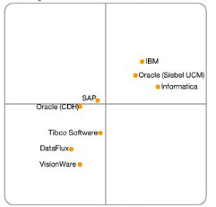
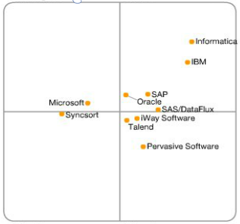
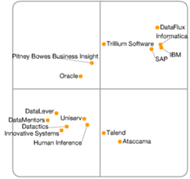
Proven Technology Leadership
No 1 Visionary in MDM
No 1 in Data Integration
No 2 in DQ
2011 MDM
Magic Quadrant
2011 Data Integration
Magic Quadrant
2011 Data Quality
Magic Quadrant
Challengers
Leaders
Challengers
Leaders
Challengers
Leaders
Ability to Execute
Niche Players
Visionaries
Niche Players
Visionaries
Niche Players
Visionaries
Source: Gartner Research (October 2011)
Source: Gartner Research (September 2011)
Source: Gartner Research (June 2011)
Completeness of Vision

Slide 5

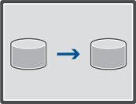
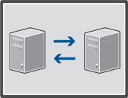
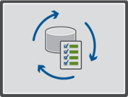





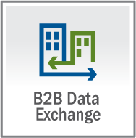




Informatica Platform
Automate The Data Integration Lifecycle To Gain A Competitive Advantage
Data Loader
Data Replication
Data Synchronization
Data Quality Assessment
Cloud Edition
Global Address Verification
Cloud Edition
PowerExchange
Identity
Resolution
Data Archive
Advanced Edition
Data Quality
Data Subset
RulePoint
Real-time Edition
Data Explorer
Data Privacy
RuleCast
Ultra Messaging (UME)
Data Exchange
Multi-domain Hub
Data Replication
AddressDoctor
Data Transformation
Dynamic Data Masking
Real-Time
Alert Manager
Business Director
Latency Buster Messaging (LBM)
Notes:
5
5
5
Looking to single out a sales rep who has done a good job in selling new product.
Last year it was Greg smith who positioned B2B, DQ, DI …
Which large transaction in 2009 includes the most number of products!
If not one single transaction, then consider multiple deals into the same account ….

Slide 6
Agenda
Introduction
MDM Partner Offering
MDM Features
Reference Data Management Accelerator
Competitive Intelligence
Enablement
Summary

Slide 7




Key MDM Partner Solution Offerings
Life Sciences
(Cloud)
Financial
Services
Life Sciences
On board
customers
faster and
support 10-50%
annual growth
Oil and Gas
Supply Chain
Manufacturing
Cloud MDM
Security Central
Customer 3D
Well Master for Oil and Gas
Customer 360
“Midas”
Cloud Offering for Mid-size Life Sciences prospects spanning customer, and spend use cases
Single view solution for securities based on the INFA FSI Templates
Single view of Customer for Life Sciences companies
Single view of Oil Well including various geo and production data types
Single view of customer for manufacturing organizations
Notes:
Offering 1 - Cognizant Cloud MDM for Life Sciences
Hosted, turn-key MDM solution that integrates data from Siebel SFA or Veeva (branded SFDC vertical solution for the pharma industry) with industry data from IMS Health to create a “golden record” of a healthcare provider and healthcare organizations. A golden record enables an organization to jump-start indicatives around aggregate spend (Sunshine Act) and analytics that require a full 360-degree view of their customers. The solution is targeted towards smaller companies in the $1-5B range that have limited internal IT resources and need to comply with regulatory requirements.
Key Data Elements - Physician, Accounts, Consumer, Product
Informatica Contacts – Overall Owner – Rolf Heimes, Technical Owner – Ron Petti
Offering 2 – Cognizant Security Central for Financial Services
Security Central is an MDM solution that allows financial institutions to create and govern a golden record for both Instruments (Securities) and Counterparties (Companies or Legal Entities). A golden record for both instrument and counterparty form a foundation for compliance reporting to meet regulations such as Basel II/III and Dodd-Frank. Security Central can also be leveraged by back-office operations to reduce the amount of transactions that need to be reconciled manually because either the instrument or counterparty is not known or can’t be recognized. The solution is geared towards institutions that don’t have the ability to view their risk exposure or that suffer from poor back-office performance.
Key Data Elements - Instrument, Counterparty
Informatica Contacts – Overall Owner – Rolf Heimes, Technical Owner – Ron Petti
Offering 3 - Deloitte Customer 3D View for Life Sciences
3D Customer is a system that enables an organization to create and manage a single ‘3D’ view of the Customer information across multiple channels of interaction. ➢ A ‘3D View’ consists of Best Version of the Customer Profile integrated with their Real Time Interactions and Preferences. This is achieved not just by de-duplicating SFA data against a 3rd Party data set (IMS / WK) but by opening the Customer Master to accept other unconventional data sources like email, Direct Mail, eDetailing, Web Portals and leveraging complex matching algorithms to build the ‘Best Address’ and ‘Best Profile’. The Complete HCP MDM solution is made of 3 key components: Customer Master, Customer Interaction Engine and Customer Preference Engine . The initial target market for this offering life sciences companies that already use Informatica MDM but want to expand the data model to include interaction data.
Key Data Elements: Customer, Physician
Informatica Contacts – Overall Owner – Duane Garrett, Technical Owner – Ron Petti
Offering 4 – Infosys Well Master for Oil and Gas
Business Problem: Energy and Petroleum (E&P) producers suffer Missed Opportunities, Increased
Operating Costs and Higher Risks of Regulatory Non-Compliance due to the lack of a integrated view of data pertaining to their most important asset, their wells.
Infosys Well Master is a solution for E&P producers to optimally manage data about their wells. The solution consists of an industry data model, templates for synchronizing data from a subset of industry systems and formats including the physical well information, geospatial information and production information.
Upsell for Data Integration and B2B DT exist for integrating with existing systems and formats such as SAP and other financial and legacy systems.
Key Data Elements: Well data, Geospatial Coordinates
Informatica Contacts – Overall Ownership – Duane Garrett, Technical Ownership – Ron Petti
Offering 5 – Wipro “Midas” – Customer 360 for High Tech/Manufacturing
Customer Centricity solution for high tech manufacturers based on Kodak’s implementation. Kodak’s CMO was the target prospect after he was unable to see a 360 degree view of his top 50 customers, his marketing spend against those key customers, the associated conversion rates of marketing campaigns and how Kodak was covering them geographically from a sales perspective.
Informatica Contacts – Overall Ownership - Vikram Ramchandra, Technical Ownership – Ron Petti
Offering consists of a customer data model, and templates for various CRM-related processes including
Channel conflict management
Marketing program efficiency
Account coverage optimization
Other Target accounts included: Sony, Lexmark, Pitney Bowes (Active), Apple (Expansion), Seagate, Tyco, Samsung, Dell, Cisco, etc.
Key Data Elements: Customer – B2B, B2C
Informatica Contacts – Overall Owner – Vikram Ramchandra, Technical Owner – Ron Petti

Slide 8
Agenda
Introduction
MDM Partner Offering
MDM Features
Reference Data Management Accelerator
Competitive Intelligence
Enablement
Summary

Slide 9

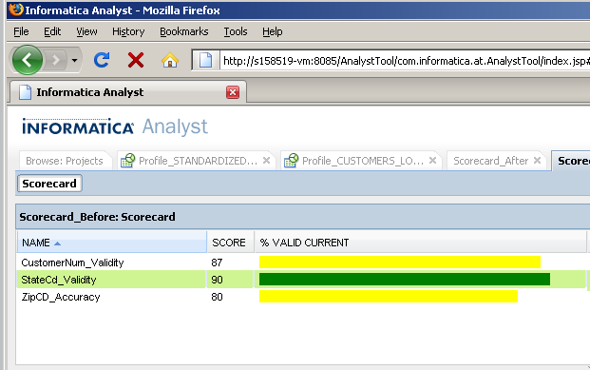
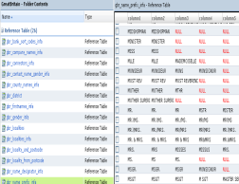
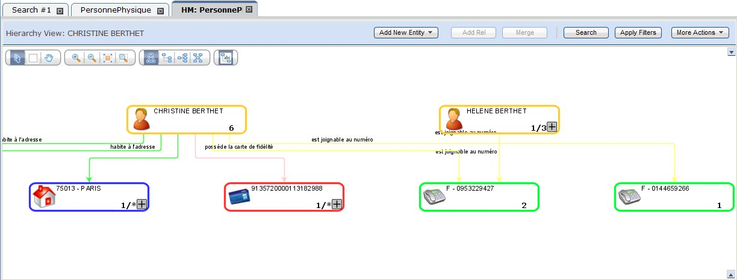




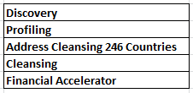








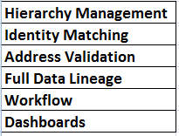






Informatica Solution
Business
Users
Applications
PowerCenter / PowerExchange
PowerCenter Real Time
BI
Exceptions
DQ Scorecard
MDM – Data Governance
Data Quality
Legacy
RDBMS
Applications
Structured
B2B Data Exchange
CEP
Proactive Monitoring
MDM
XML
Legacy
MetaData Manager

Slide 10








































Informatica MDM Core Capabilities
Deliver
Sync
Federate
Business Interaction
Govern
Monitoring & Scorecard
Data Stewardship
Workflow
Relate
Party
Product
Party
& Product
Resolve
Merge
Trust Framework
Unmerge
Data
Services
Recognize
Deterministic
& Fuzzy Logic
Internationalization
Cleanse
Data
Cleansing
Address
Standardization
Open
Cleanse
Architecture
Master
Data
Management
Single or Multidomain
Metadata
Content
Configuration
Model
History
Lineage
Match
Survivorship
Validation Rules
Customer
Product
Data
Quality
Discover
Profiling
Analysis
Discovery
Data
Integration
Access
Batch or
Real-time
All Data
Sources
All Data
Formats

Slide 11

























Informatica – Universal MDM
1
Data Domains
2
Architectural Styles
Customer
Product
Registry
Consolidation
Household
Universal
MDM
Organization
Coexistence
Centralized
3
Deployment Modes
4
Uses
Data Integration
Data Quality
On premise
Cloud
Hybrid
Data Profiling
Data Services
Internal & Channel Partner use only

Slide 12







Multi-Deployment
Wherever, Whenever, However…
Federated MDM
Different instances for various divisions (M&A, Regulatory,…)
Support cross-enterprise, cross-instance business processes
Interoperability and Consistency
MDM in the Cloud
Initial Loading
Performance Bursting
User Acceptance Testing
Partner-driven processes/data
MDM as a Service
For Cloud Applications
Shared dataset
Shared business process
Value added services
Customer
Product
…
Internal & Channel Partner use only

Slide 13
Agenda
Introduction
MDM Partner Offering
MDM Features
Reference Data Management Accelerator
Competitive Intelligence
Enablement
Summary

Slide 14
Vendor – Competitive Summary
 | Informatica | First Tier (Golden Source, Asset Control) | Second Tier (Polar Lake, Cadis, Eagle Pace) | Custom Solutions
OOB Data Model & Rules
OOB Data Feed integration
Specialized Financial Analysis Apps
Data Model and rules customization
Data Feed customization
Flexible business UI
Time to Value
License and TCO
Scalability and performance
Data Governance and Data Quality
Services / APIs / Integration
Multi-domain coverage

Slide 15
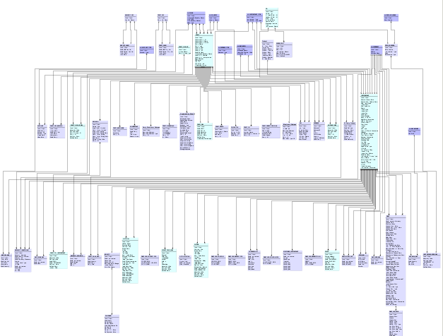
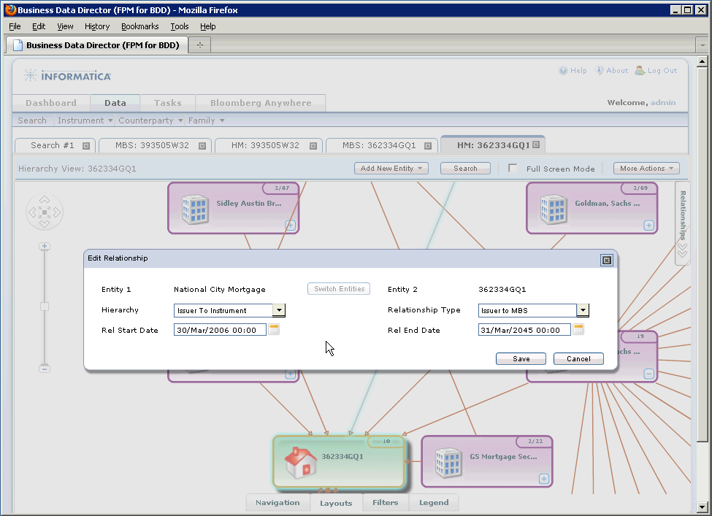
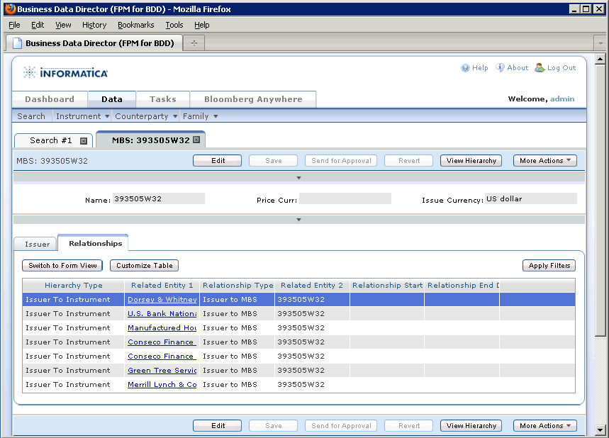
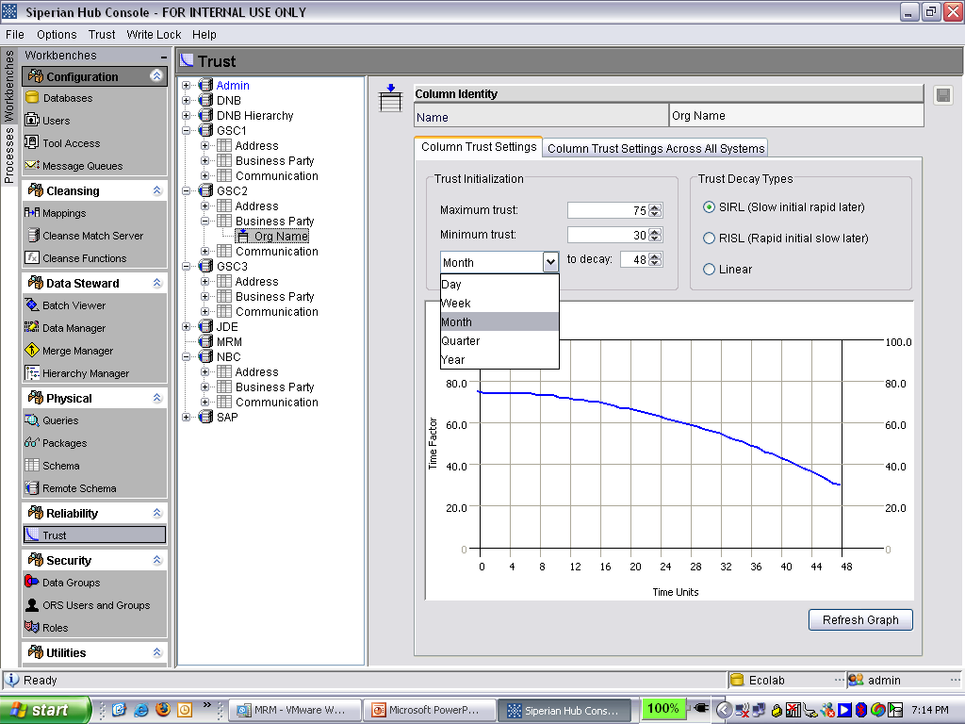
FS - Reference Data Management
Comprehensive data model:
~ 75 entity types,
~ 12 instrument types,
~ 40 relationship types
Robust Rules Package -
Data Quality, Match, Survivorship
Out-of-the-box business user interface
Out-of the box analyst interface
Notes:
Talk about balance of data model while enforcing compliance and backward compatibility

Slide 16




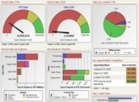
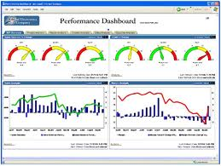























Counterparty Reference Data
KEY BUSINESS IMPERATIVE
Improve Credit Risk Management Analysis and Regulatory Compliance (i.e. Basel, Dodd-Frank Act)
The Challenge
Inconsistent and inaccurate counterparty information in existing risk applications
Inaccurate risk rating and analysis = higher capital reserves
Non-compliance with Basel requirements
Credit risk
Market risk
Operational risk
Informatica Advantage
Ability to access existing counterparty information regardless of source and format
Identify and address unforeseen data quality issues
Accurately recognize, resolve, and relate counterparties to each other with detailed hierarchies
Synchronize with downstream systems and databases
Data Stewards
Data Integration & Data Quality
Expected Benefits
  Consistent and accurate counterparty information to improve credit risk exposure analysis and reporting
  Achieve Basel and other regulations
Existing Data
Cities
Banks
Cities
Corporations
Corporations
Banks
Ltd. Partnerships
Insurance
Companies
Broker/Dealer
Insurance
Companies
Ltd. Partnerships
Broker/Dealer

Slide 17

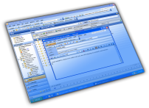







Counterparty
Centralize, manage, and manipulate Counterparty relationships providing a global view of exposure
Rating
Exposure
Counterparty A
Counterparty B
Global Ultimate
Rating
Position
Position
Rating
Subsidiary
Portfolio
Portfolio
Issuer
Obligor
DEF Mutual Funds
-----------
-----------
GHI Bonds
-----------
-----------
JKL Securities
-----------
-----------
MNO Mortgage
-----------
-----------
Rating
Notes:
Now that you have the Golden Records and counterparty relationships, you can link it all together to have an integrated view of counterparty risk exposure
To achieve a high level of capital efficiency, institutions require the ability to provide a consistent global counterparty representation, a consistent rating across all product types and to aggregate counterparty risk throughout the counterparty’s hierarchy of subsidiary entities — accurately and rapidly. Furthermore, risk managers want to view aggregate exposures according to exposure mitigation techniques. This requires flexibility in risk analysis, reporting and drill down to consolidate exposure at different levels such as bank structure, asset class, geography, product attribute, and so on.
For example, a single unified counterparty view consolidates the complete credit exposure per ultimate based on the complete legal hierarchy. If there is a obligor behind the counterparty, the obligor’s creditworthiness must also be considered. A highly disciplined approach to data management is required to solve the ever increasing data volumes and sources and the complex nested structures covering many jurisdictions, and the linkage to increasingly complex credit instruments.

Slide 18





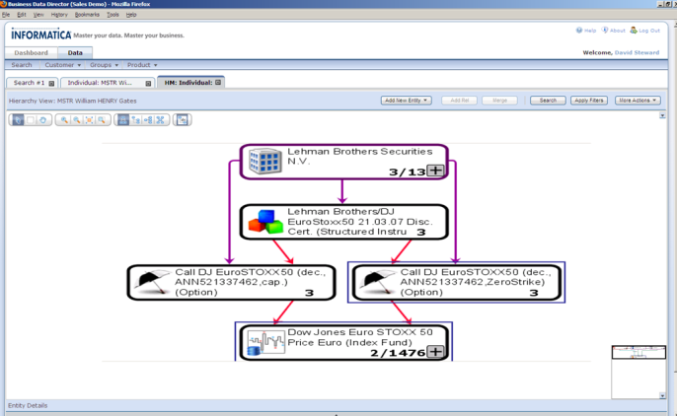





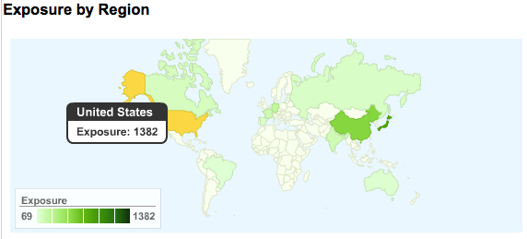
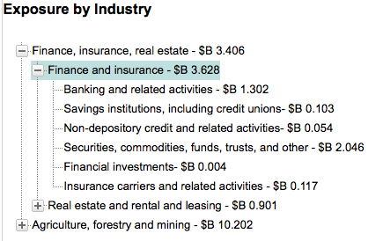
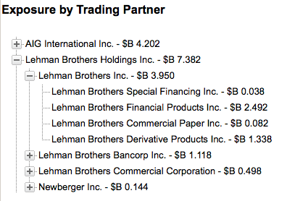
Managing Counterparty Reference Data with Informatica MDM
Existing Counterparty Data in Different Systems
Cities
Banks
Corporations
Ltd. Partnerships
Insurance
Companies
Broker/Dealer
Cities
Banks
Corporations
Ltd. Partnerships
Insurance
Companies
Broker/Dealer
Cities
Banks
Corporations
Ltd. Partnerships
Insurance
Companies
Broker/Dealer
Golden Record
Legal Entity Identification
Define Relationship Hierarchies
Cities
Banks
Corporations
Ltd. Partnerships
Insurance
Companies
Broker/Dealer

Slide 19
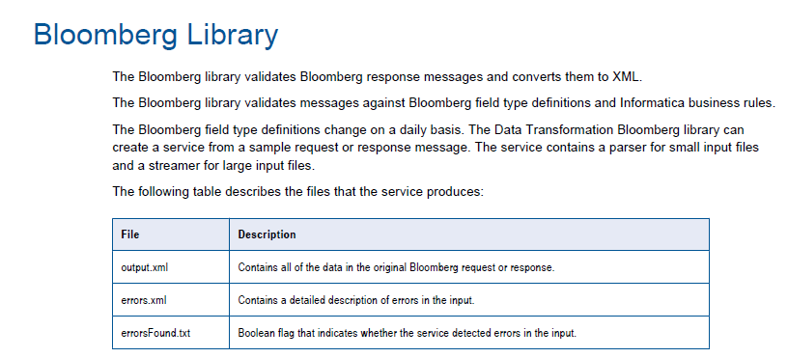
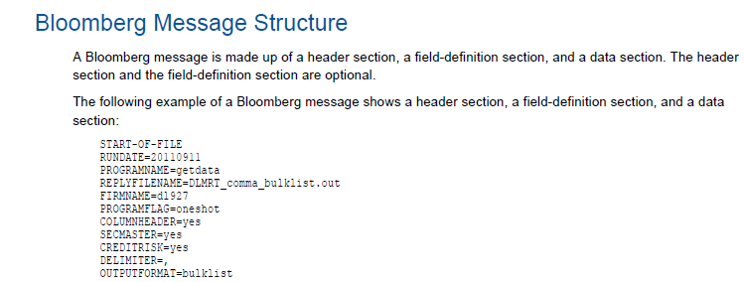
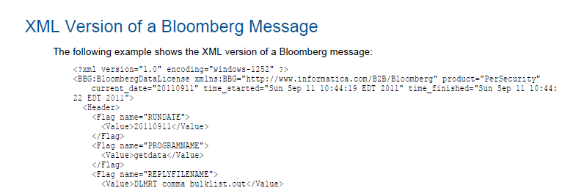

Slide 20
Agenda
Introduction
MDM Partner Offering
MDM Features
Reference Data Management Accelerator
Competitive Intelligence
Enablement
Summary

Slide 21
Competitor | Customer Perception | Risk | Informatica Differentiators
Hand-coding | Build an MDM solution using various data integration and data quality tools | MDM is a complex problem and very expensive to build & maintain Companies that build their own solutions find they spend expensive resources to build case-level functionality that yield high cost and low value | Pre-built, proven MDM product that can allow a customer to get rapid business value, while being able to support future requirements with a low TCO
IBM | Scalable transactional MDM readymade for banking and insurance | Fixed, inflexible data model required extensive coding & customization resulting in high risk, big-bang implementations Speed to deliver during the sales cycle as well as post sale is hindered by their excessive resourcing to execute | Informatica supports multiple data domains (product, customer, account etc..) Informatica MDM unifies all MDM requirements on the same platform Informatica is easy to configure and change to accommodate new business needs
Initiate (IBM) | Accurate matching with fast implementations | Black box technology places continuous dependence on Initiate’s services for implementation and on-going maintenance Not proven for use beyond indexing
Oracle | Industry-specific MDM solutions will enable faster go-live | Multiple overlapping MDM products that only address a single problem (e.g. customer) and do not always work together Difficult to use and requires complex coding Immature Fusion MDM release | Informatica supports multiple data domains Informatica MDM unifies all MDM requirements on the same platform Because MDM relies on our platform, it works with virtually any application or data source Informatica is easy to configure and change to accommodate new business needs
SAP | Single provider of all enterprise software | Least proven of all MDM products with Product Data heritage Customers face difficult adapting it for customer MDM since matching, merging and hierarchy management is poor | Because MDM relies on our platform, it works with virtually any application or data source Informatica is easy to configure and change to accommodate new business needs
Internal & Channel Partner use only

Slide 22
Agenda
Introduction
MDM Partner Offering
MDM Features
Reference Data Management Accelerator
Competitive Intelligence
Enablement
Summary

Slide 23
MDM - Enablement
Quick Start | Education | Services
INFORMATICA
Quickstart Page >> Resource Center >> MDM hub Business Data Director | 4 day MDM Multidomain edition 3 day for SIF 1 day IDD for Business Users 3 day Configuring IDD 2 week IPS lead boot camp Register >> More info >> | Support Log Support Request Documentation Knowledge Base How to Library Professional Services IPS if required Email IPS for ramping
DELIVERY
beINFORMed >> Login Required New Users >> | Virtual Academy On-Site Public courses | Myinformatica >> Login Required New Users >>

Slide 24
Agenda
Introduction
MDM Partner Offering
MDM Features
Reference Data Management Accelerator
Competitive Intelligence
Enablement
Summary

Slide 25
Informatica Solution
Business
Users
Applications
PowerCenter / PowerExchange
PowerCenter Real Time
BI
Exceptions
DQ Scorecard
MDM – Data Governance
Data Quality
Legacy
RDBMS
Applications
Structured
B2B Data Exchange
CEP
Proactive Monitoring
MDM
XML
Legacy
Metadata Manager

Slide 26
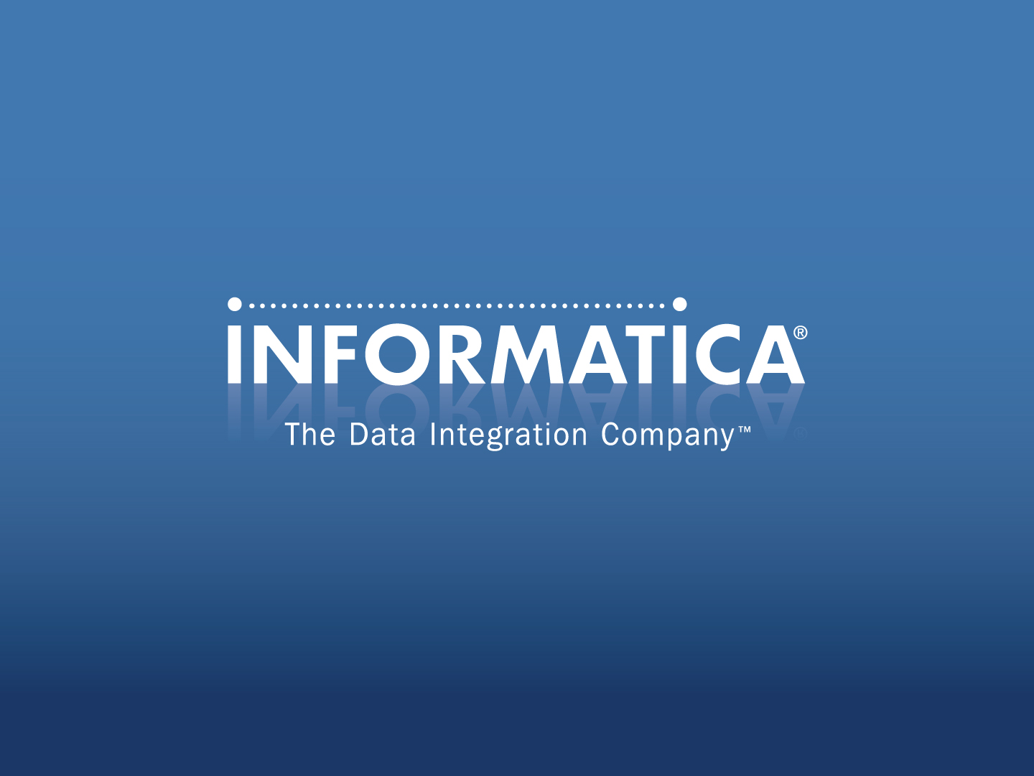

Slide 27
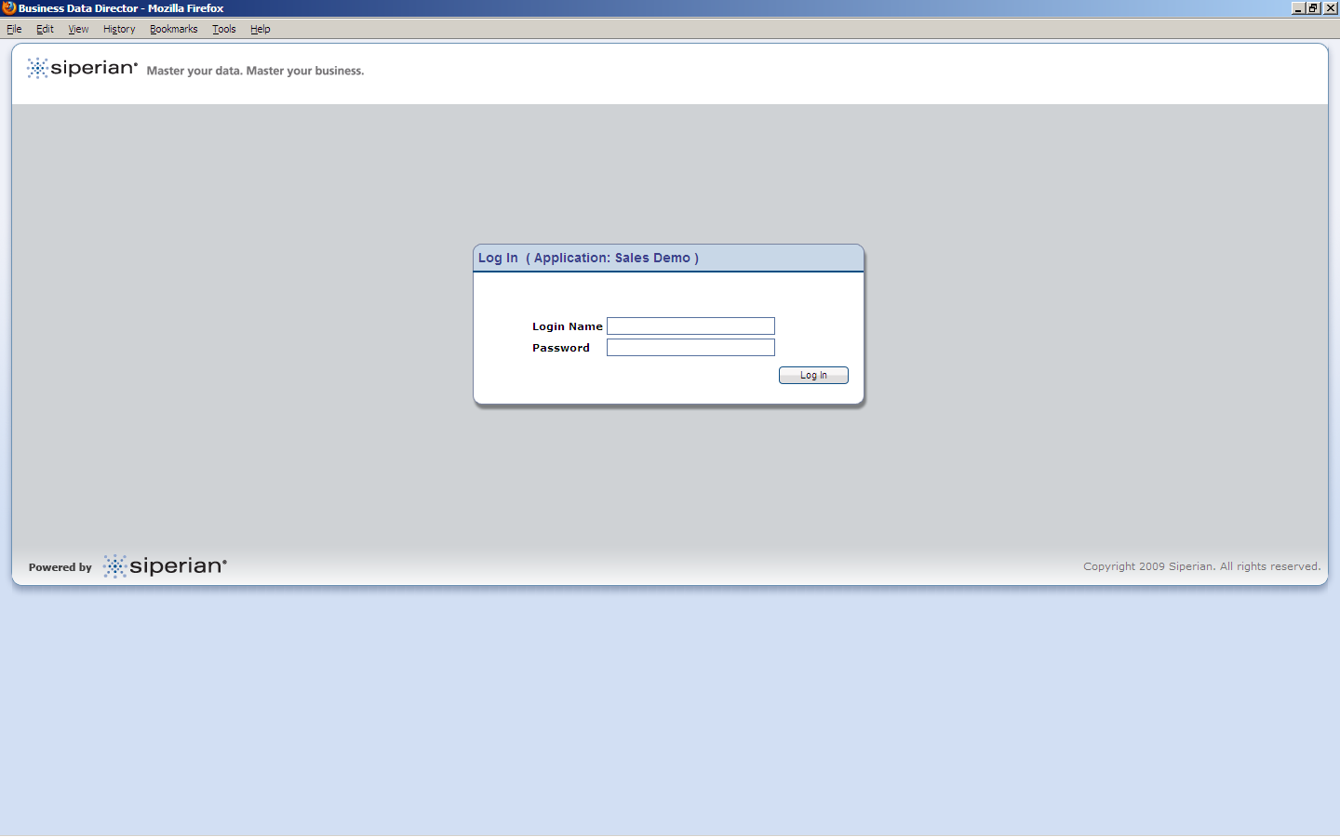

Slide 28
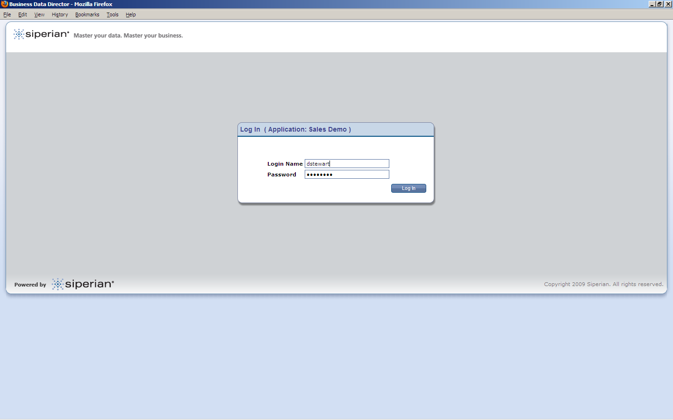

Slide 29
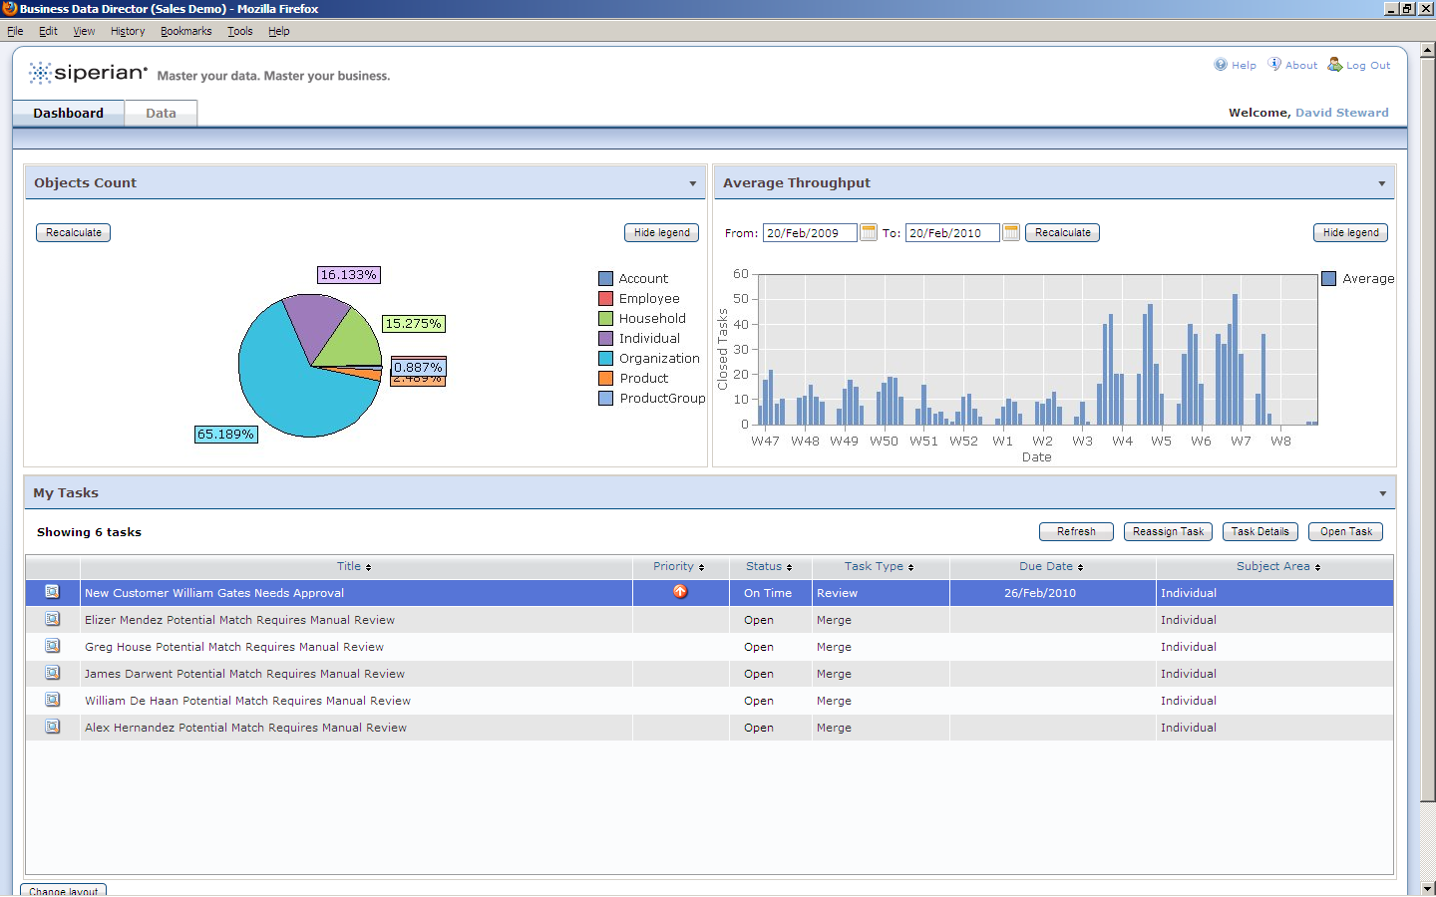

Slide 30


Slide 31
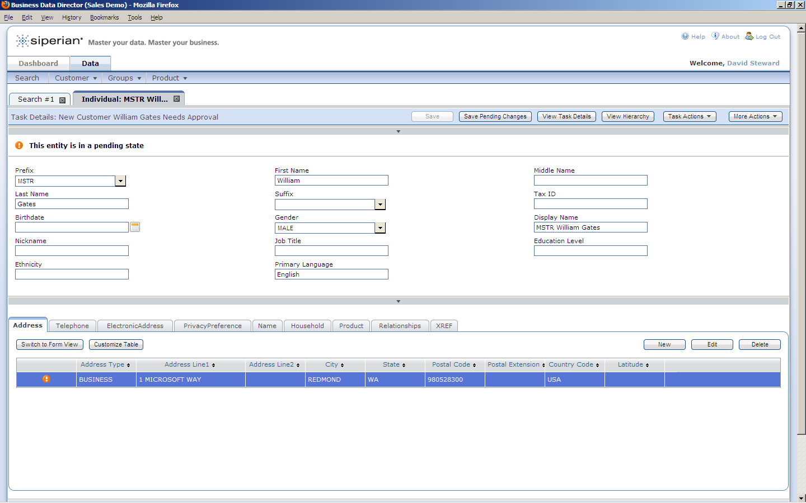

Slide 32
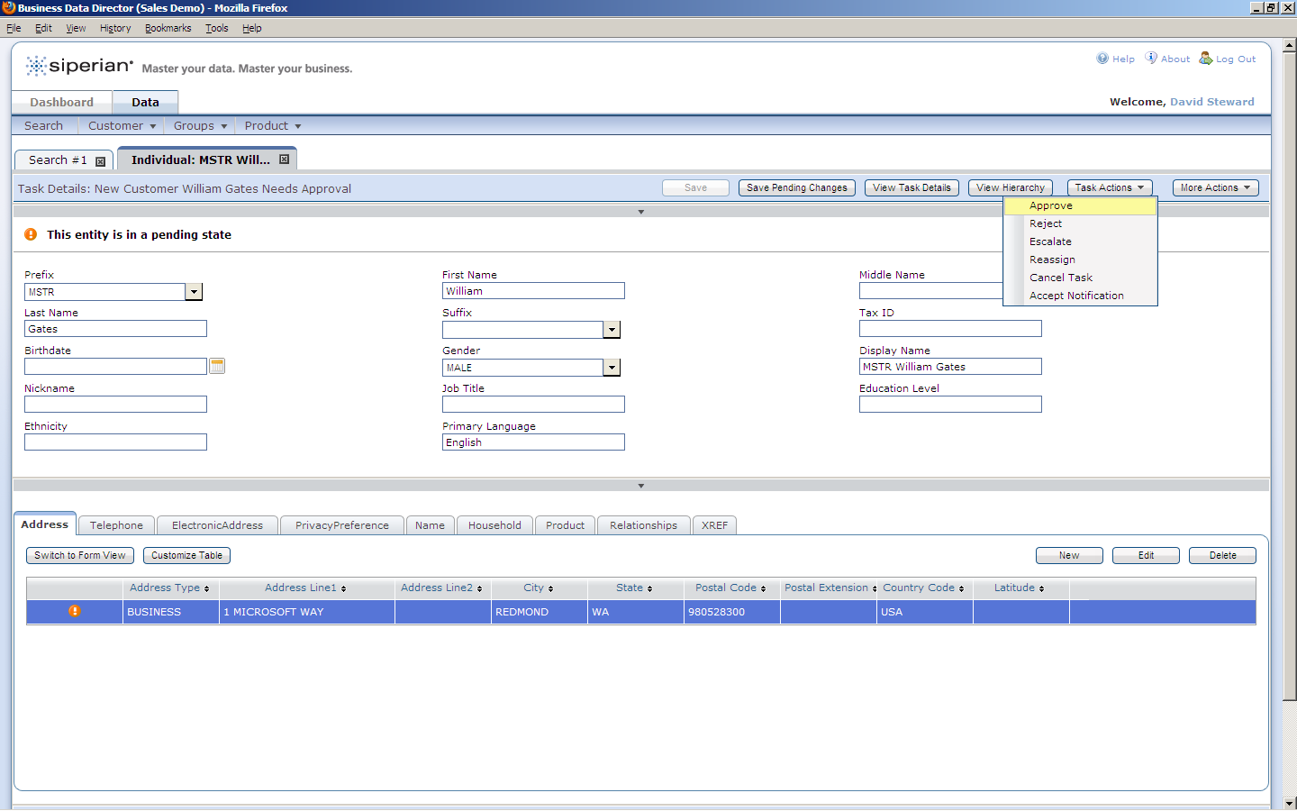

Slide 33
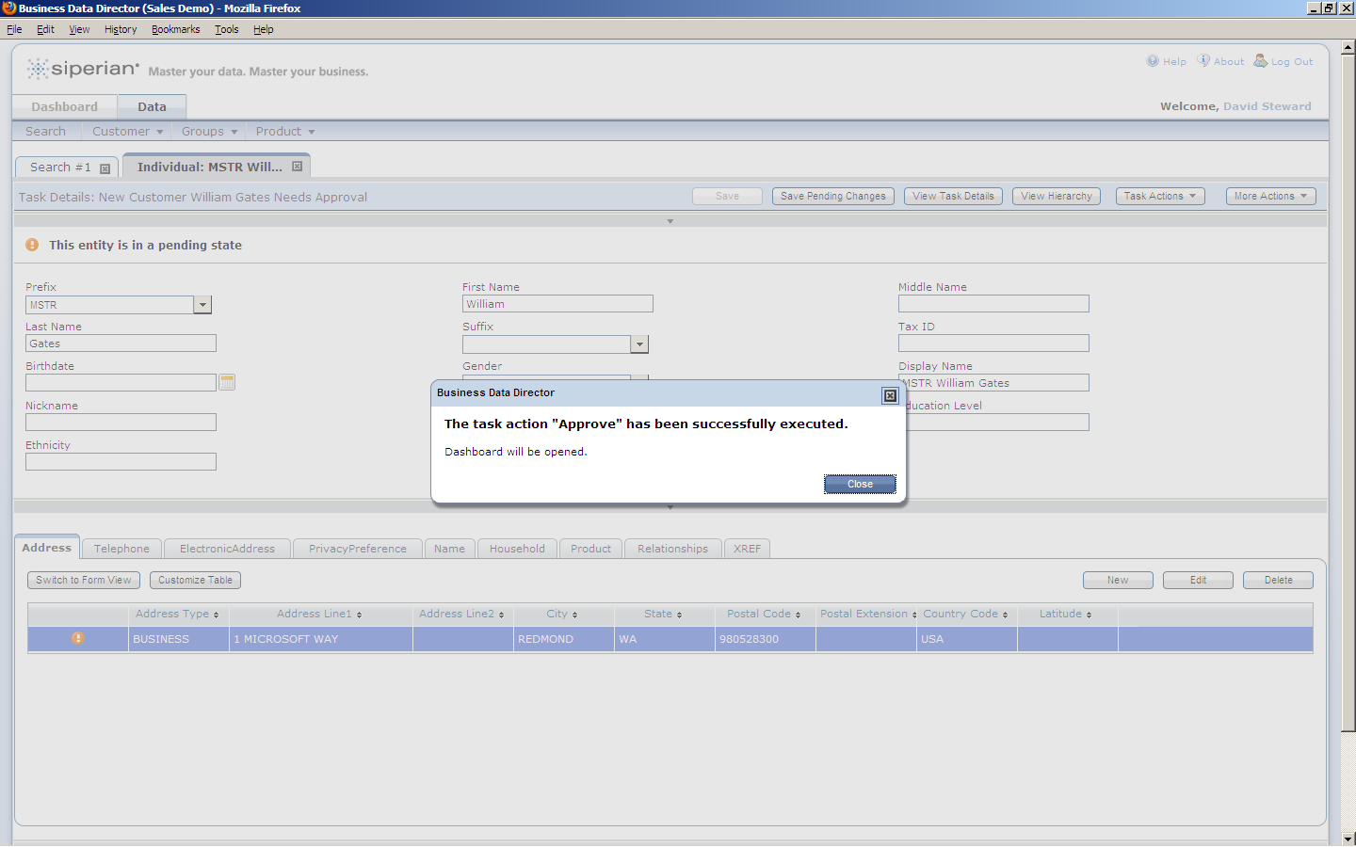

Slide 34


Slide 35
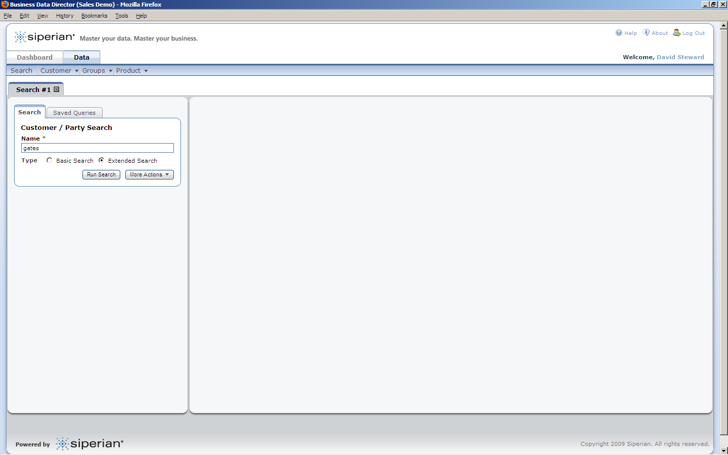

Slide 36
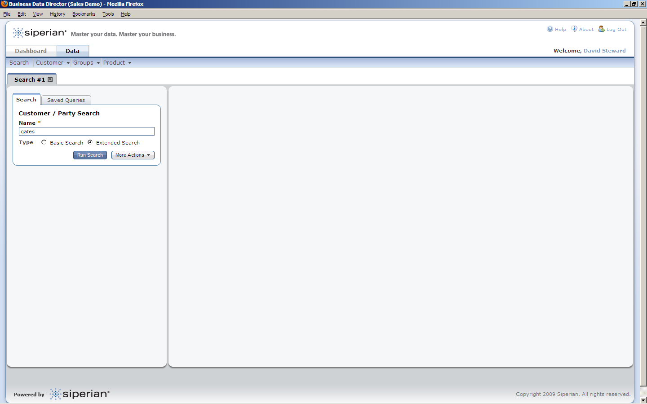

Slide 37
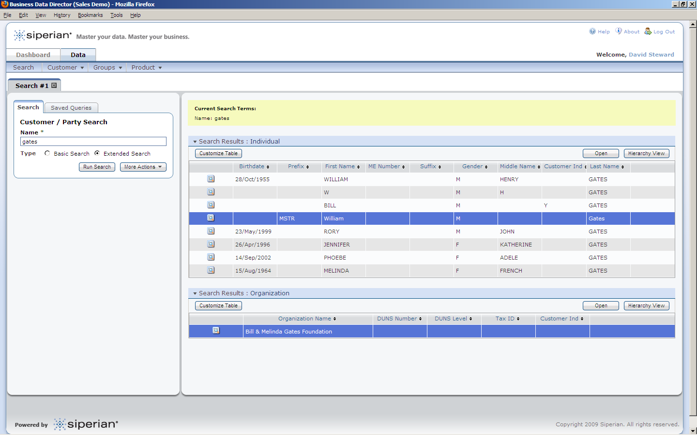

Slide 38
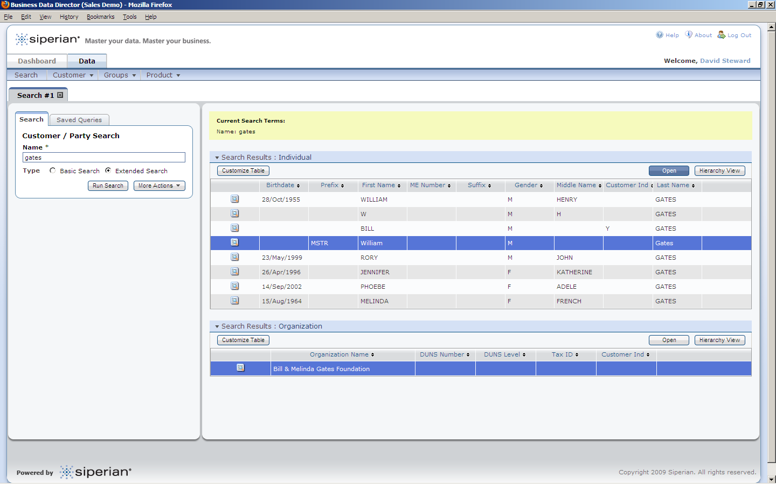

Slide 39
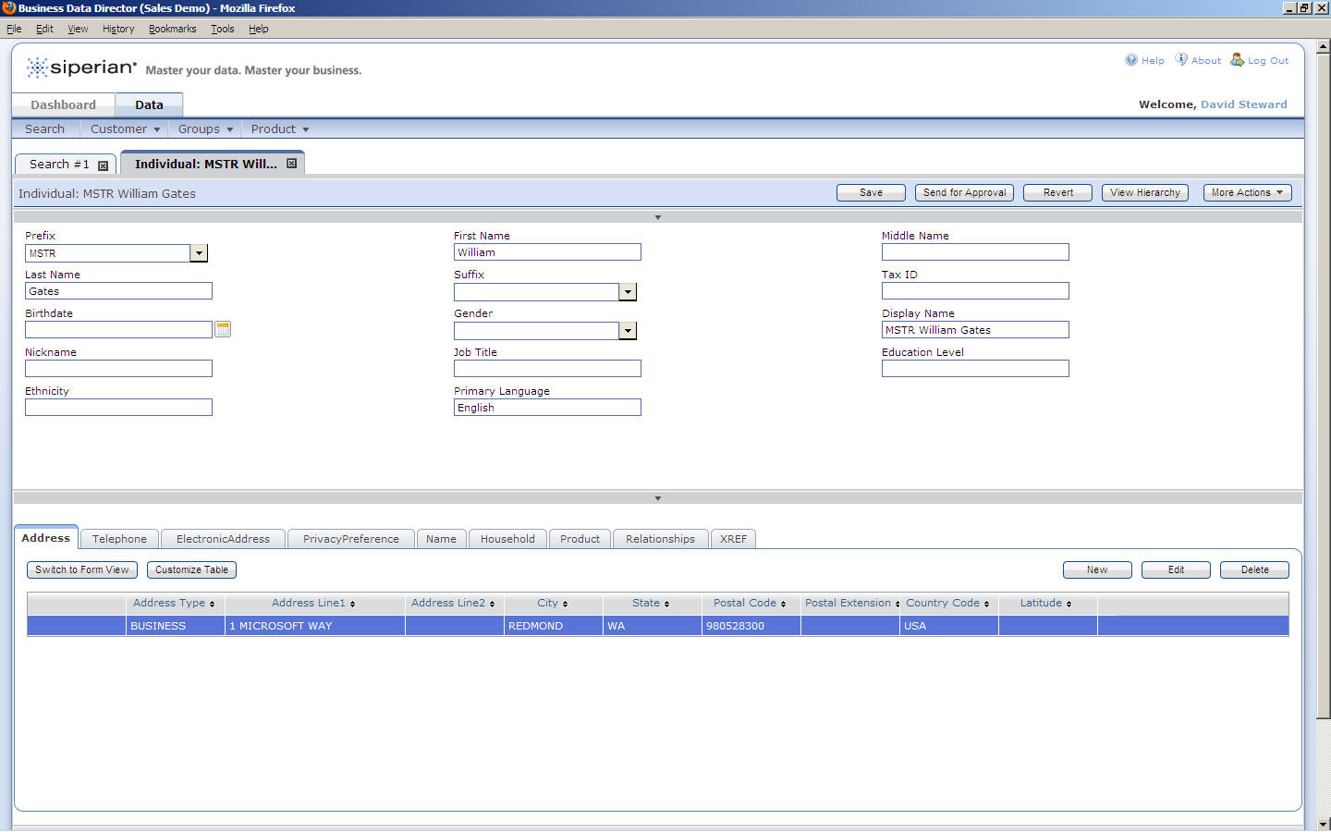

Slide 40
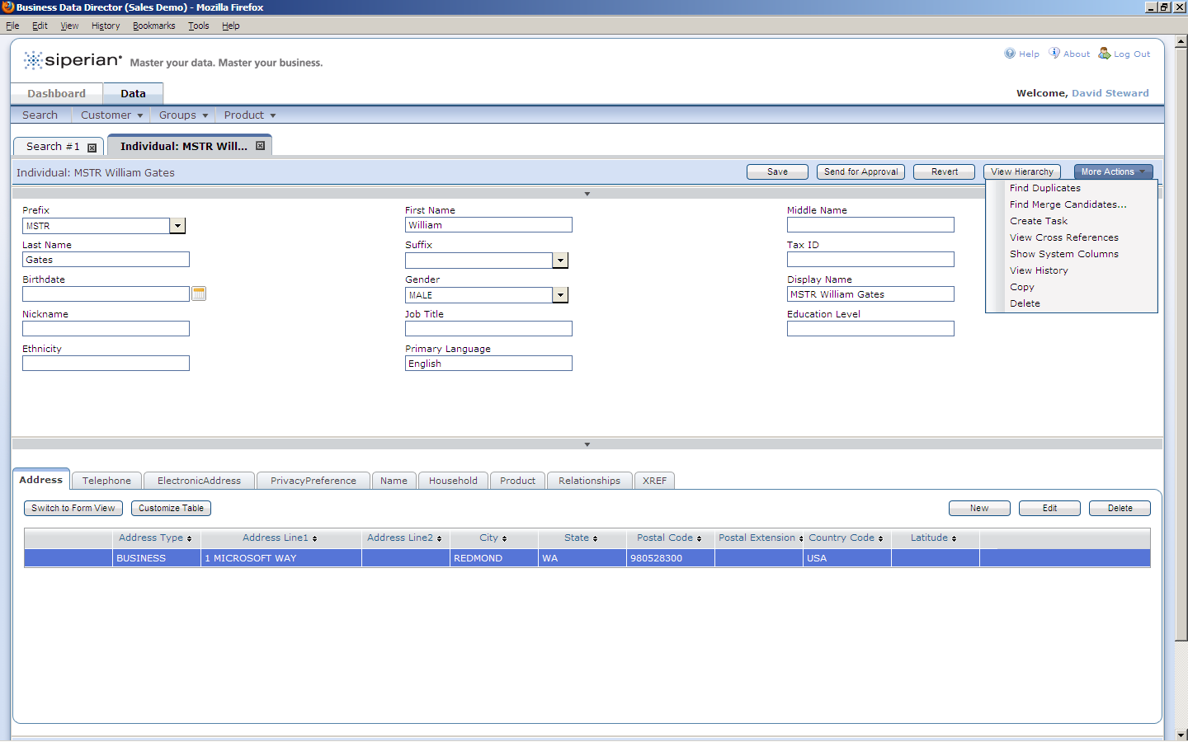

Slide 41
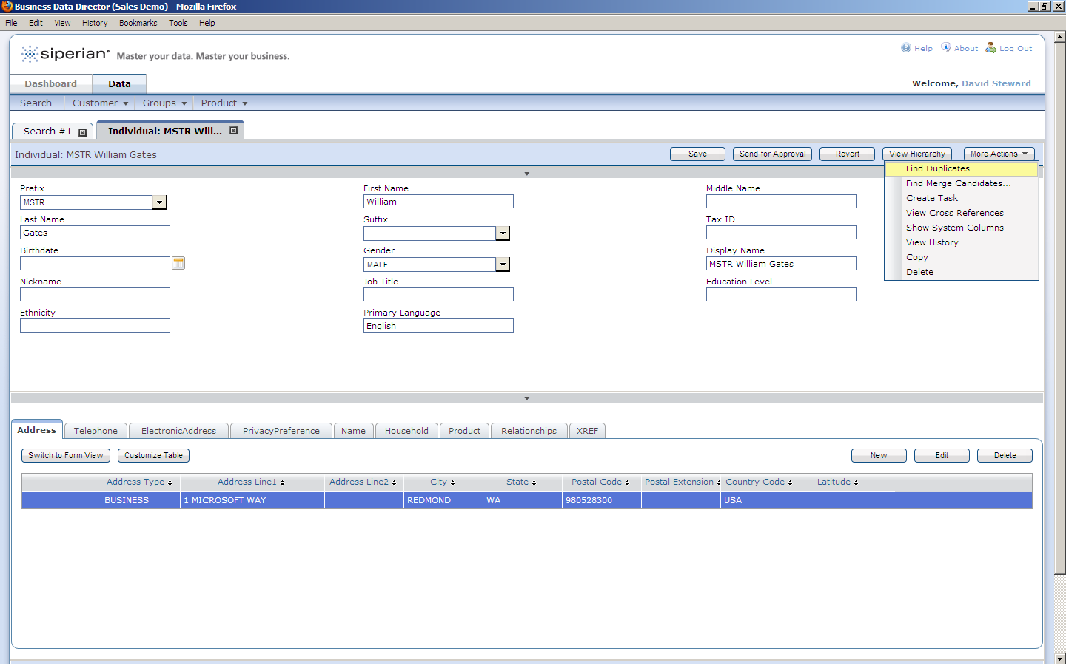

Slide 42
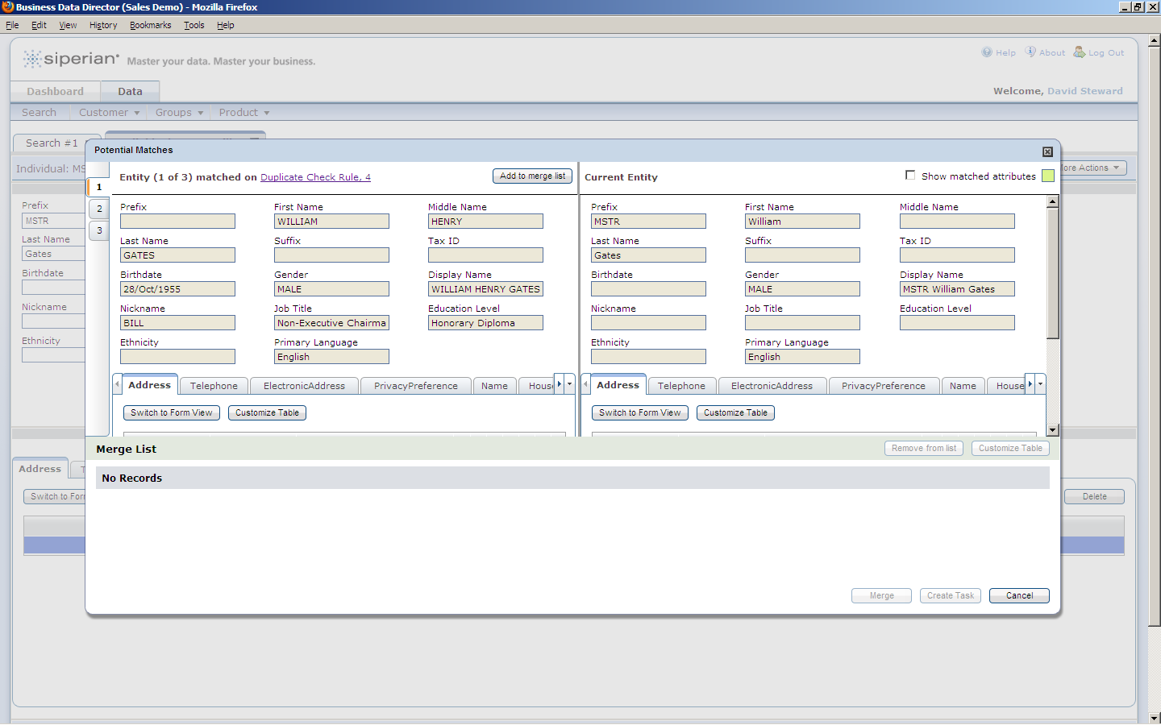

Slide 43
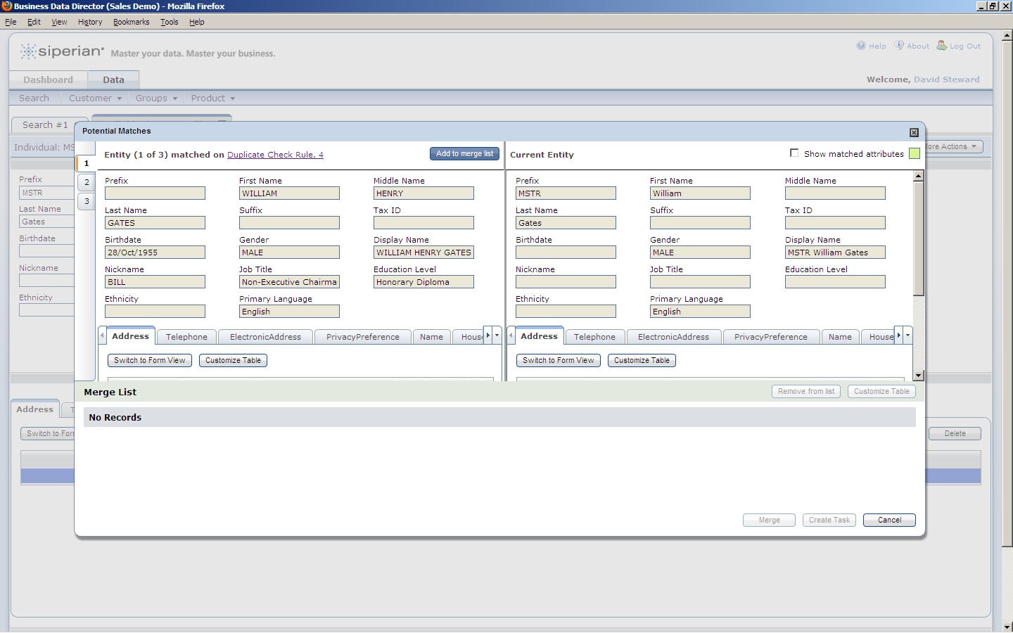

Slide 44
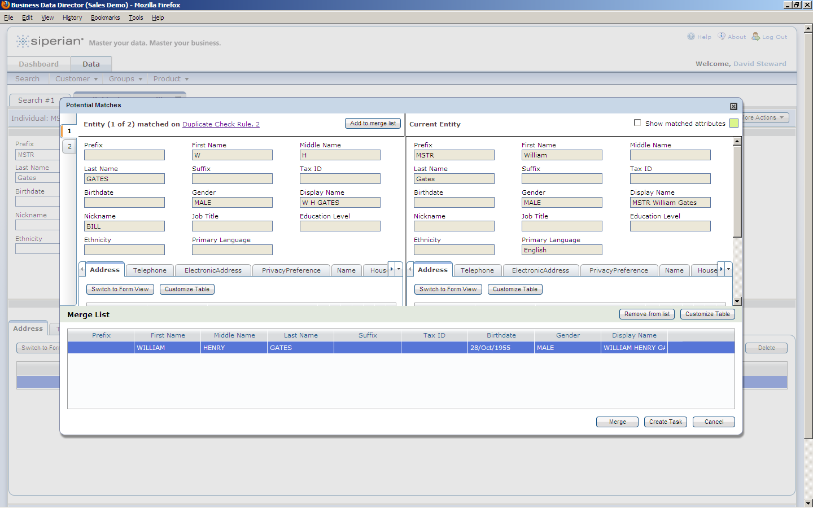

Slide 45
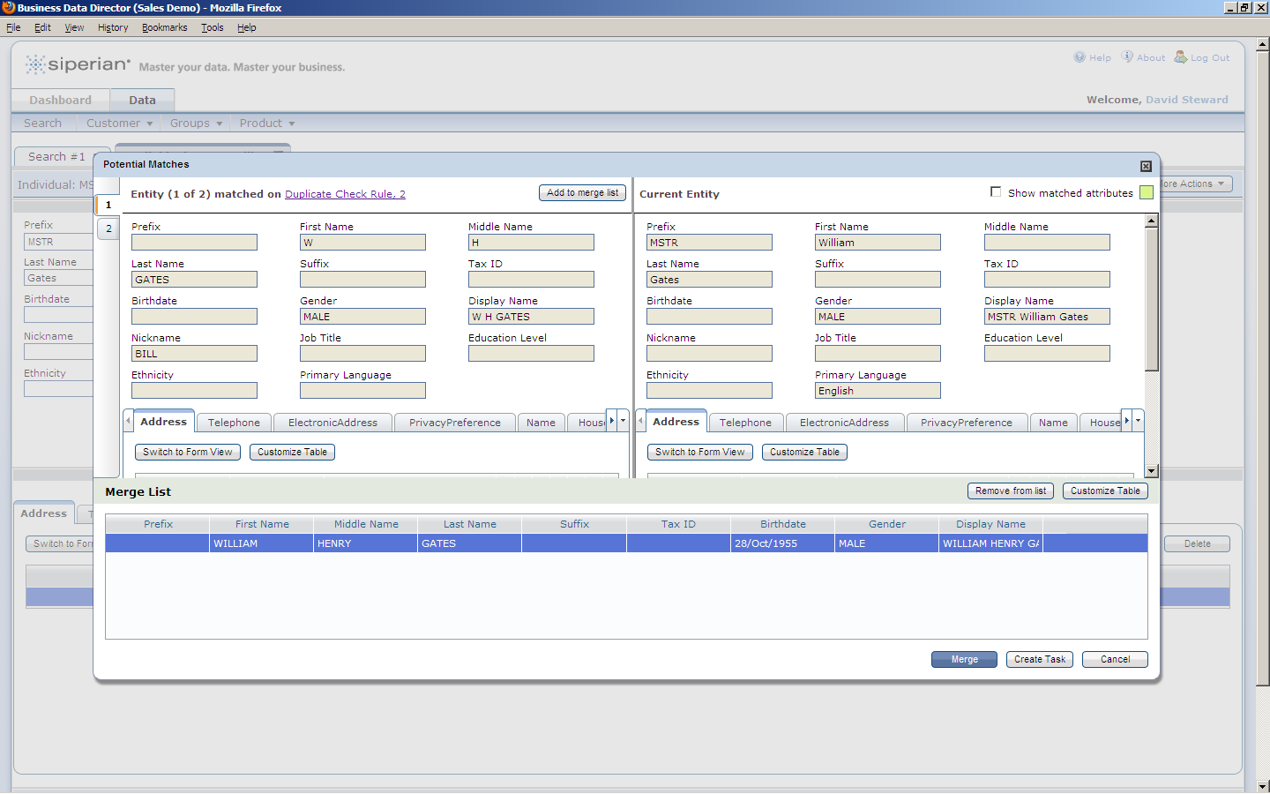

Slide 46
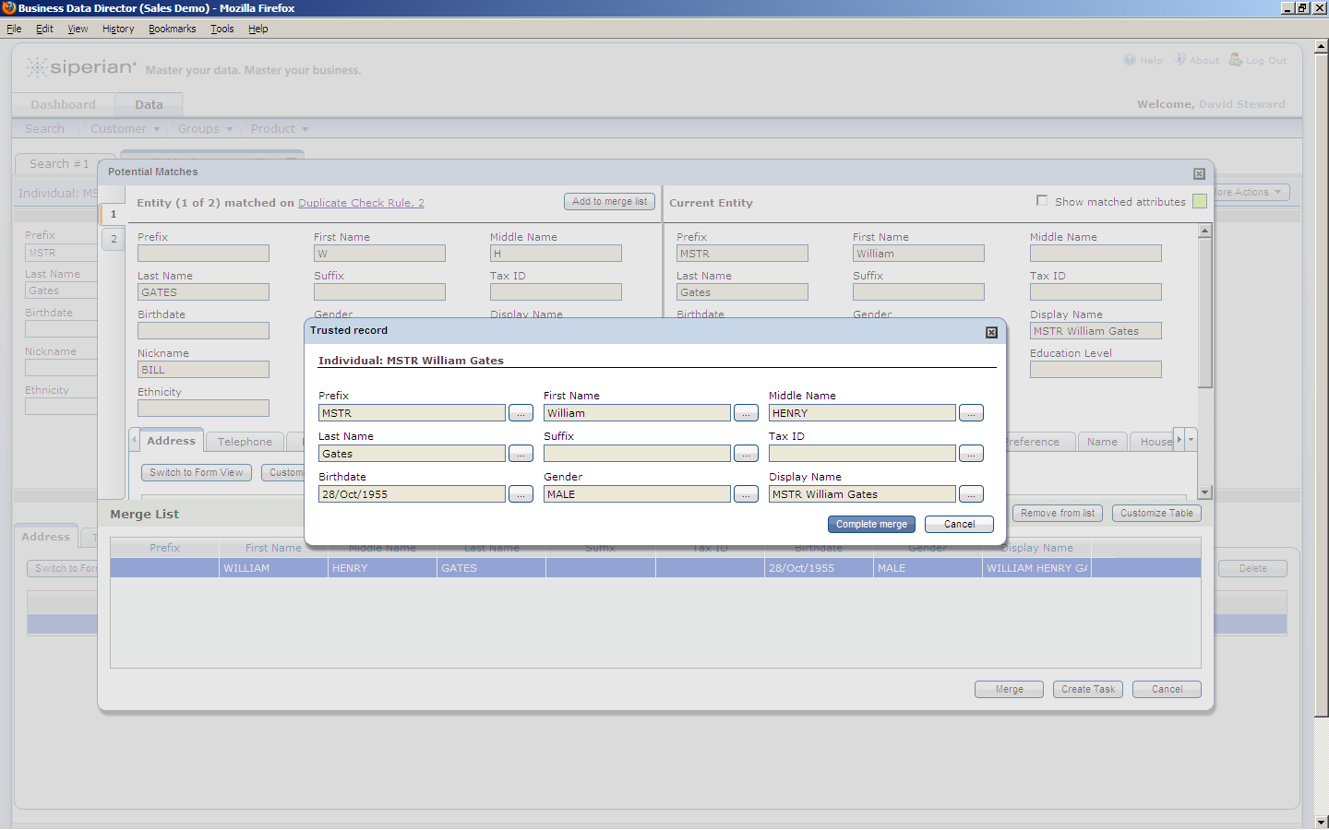

Slide 47
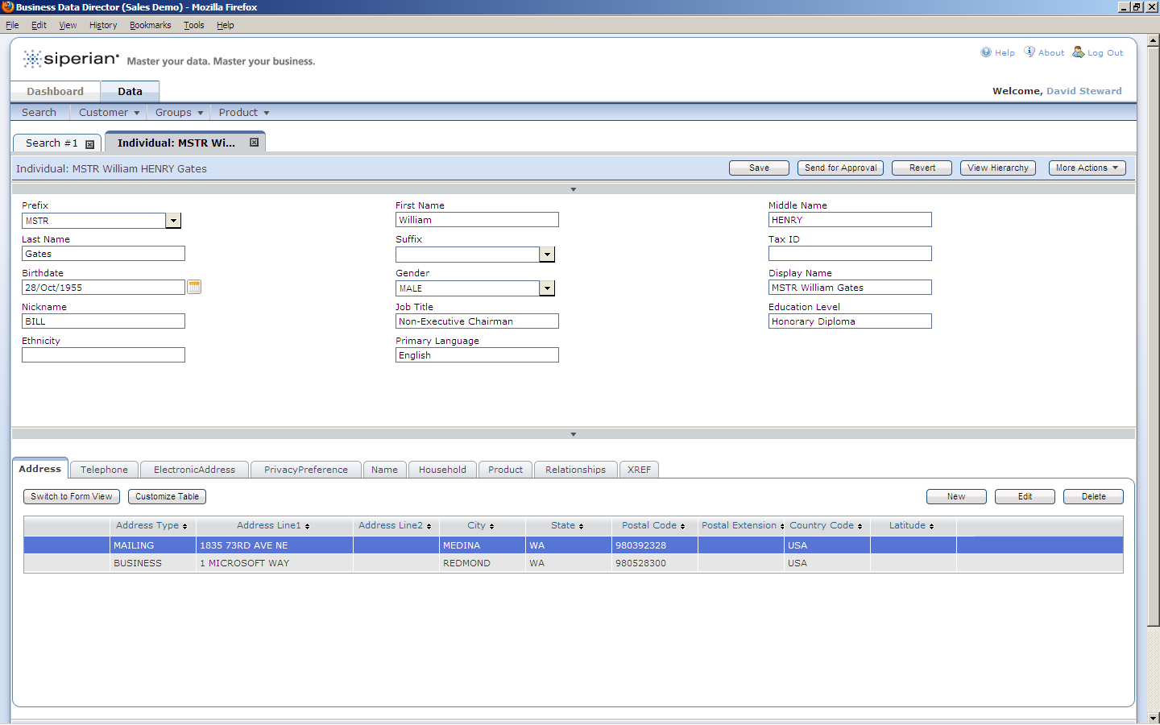

Slide 48
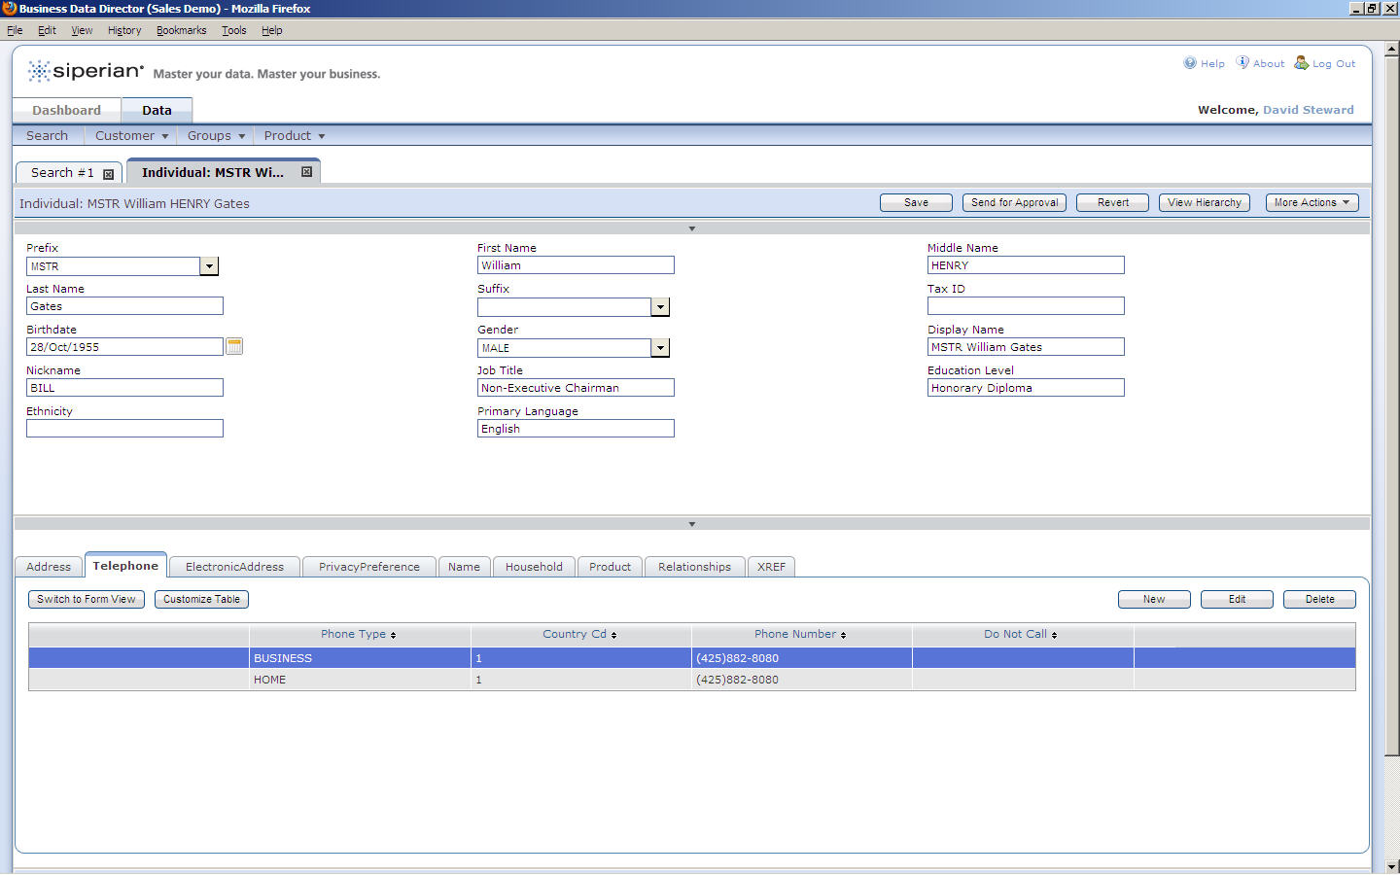

Slide 49
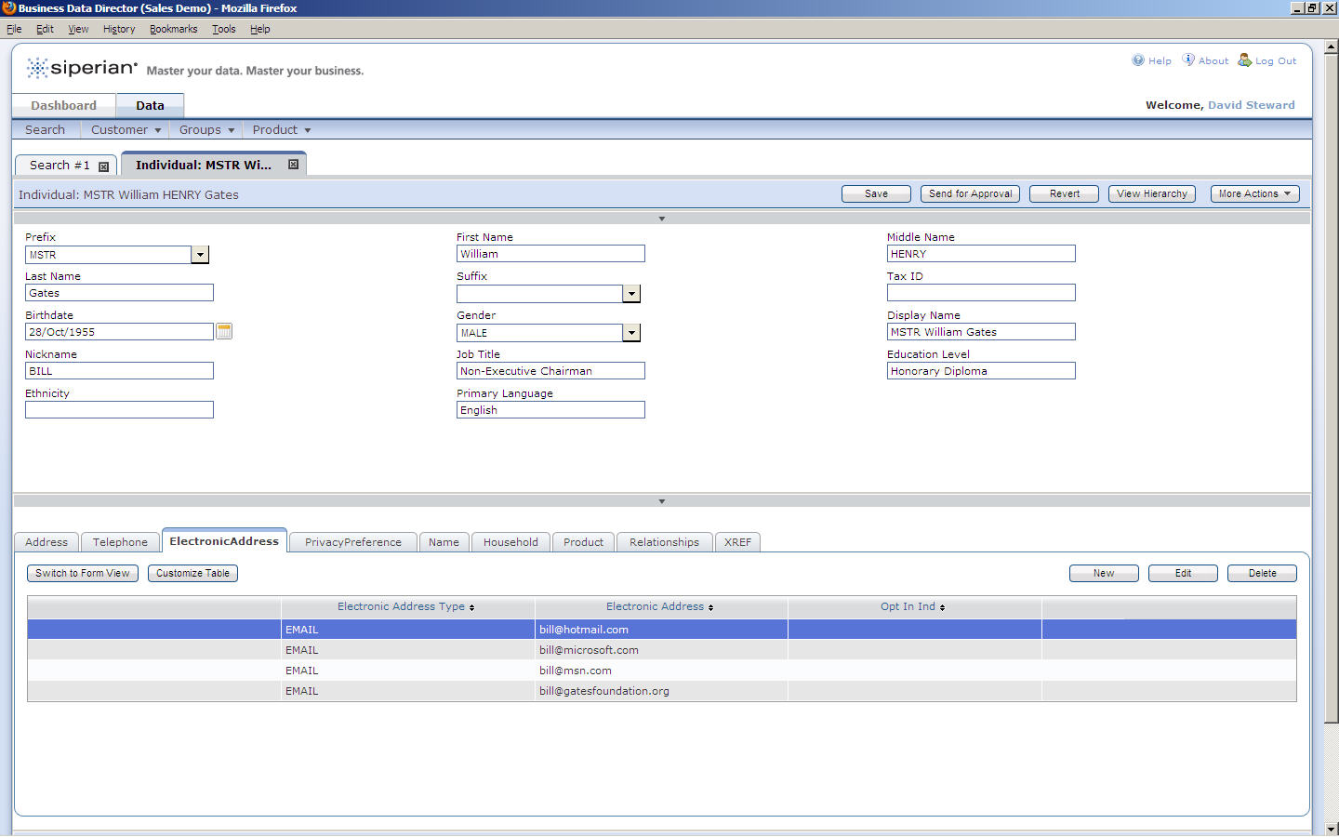

Slide 51
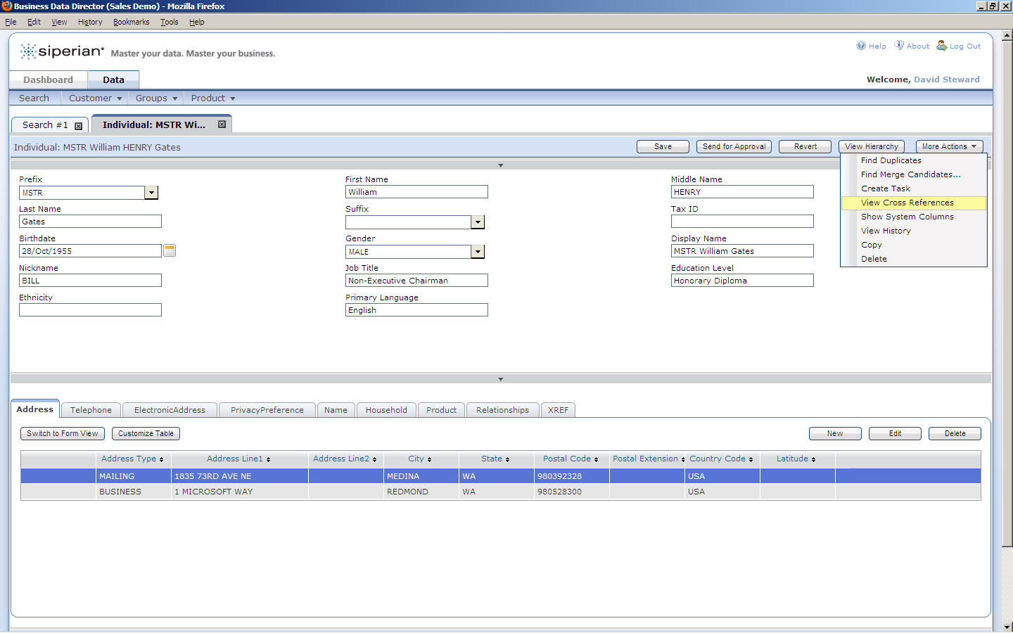

Slide 52


Slide 53


Slide 54


Slide 55


Slide 56


Slide 57


Slide 58


Slide 59


Slide 60


Slide 61


Slide 62


Slide 63


Slide 64


Slide 65


Slide 66


Slide 67


Slide 68


Slide 69


Slide 70


Slide 71


Slide 72


Slide 73


Slide 74


